Slide 1

Continuous Delivery For Modules to the PowerShell Gallery
Rob Sewell @sqldbawithbeard https://sqldbawithAbeard.com

Slide 2
speaker questionnaire
Name : Rob (although Chrissy calls me Beard ☺ )
Occupation : DBA, Automator, Do-er, Trainer, DevOpser!
Available for hire ☺ - RobSewell.info
Interests : PowerShell, Automation And SQL (PaaS geddit?)
Interesting Fact : Beard. (Still) Plays Cricket, Flies Drone
Speaker : PsConfEU, PsConfAsia, PSSaturdays, PSMondays, User Groups PowerShell and SQL
Community : PowerShell VG, PowerShell Conference EU Organiser, PSDayUK Organiser, SQL South West , SQL Sat Exeter , dbareports, dbatools, dbachecks, MVP

Slide 3
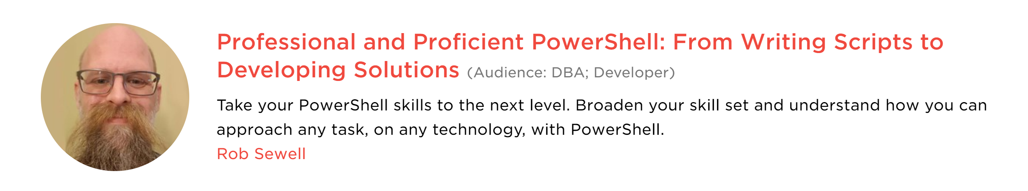
Join Me at PASS Summit
sqlps.io/precon

Slide 4
TODAY’s TO DO LIST
GET UP
Drink Appropriate Liquid
Create Continuous Delivery Process for Delivering Modules to the PowerShell Gallery

Slide 5
What do we need?
Plaster – Install-Module Plaster
Pester – Install-Module Pester (Need to take ownership and remove existing Pester folder first)
GitHub Account
VSTS account
We won‘t have time for much detail!!

Slide 6
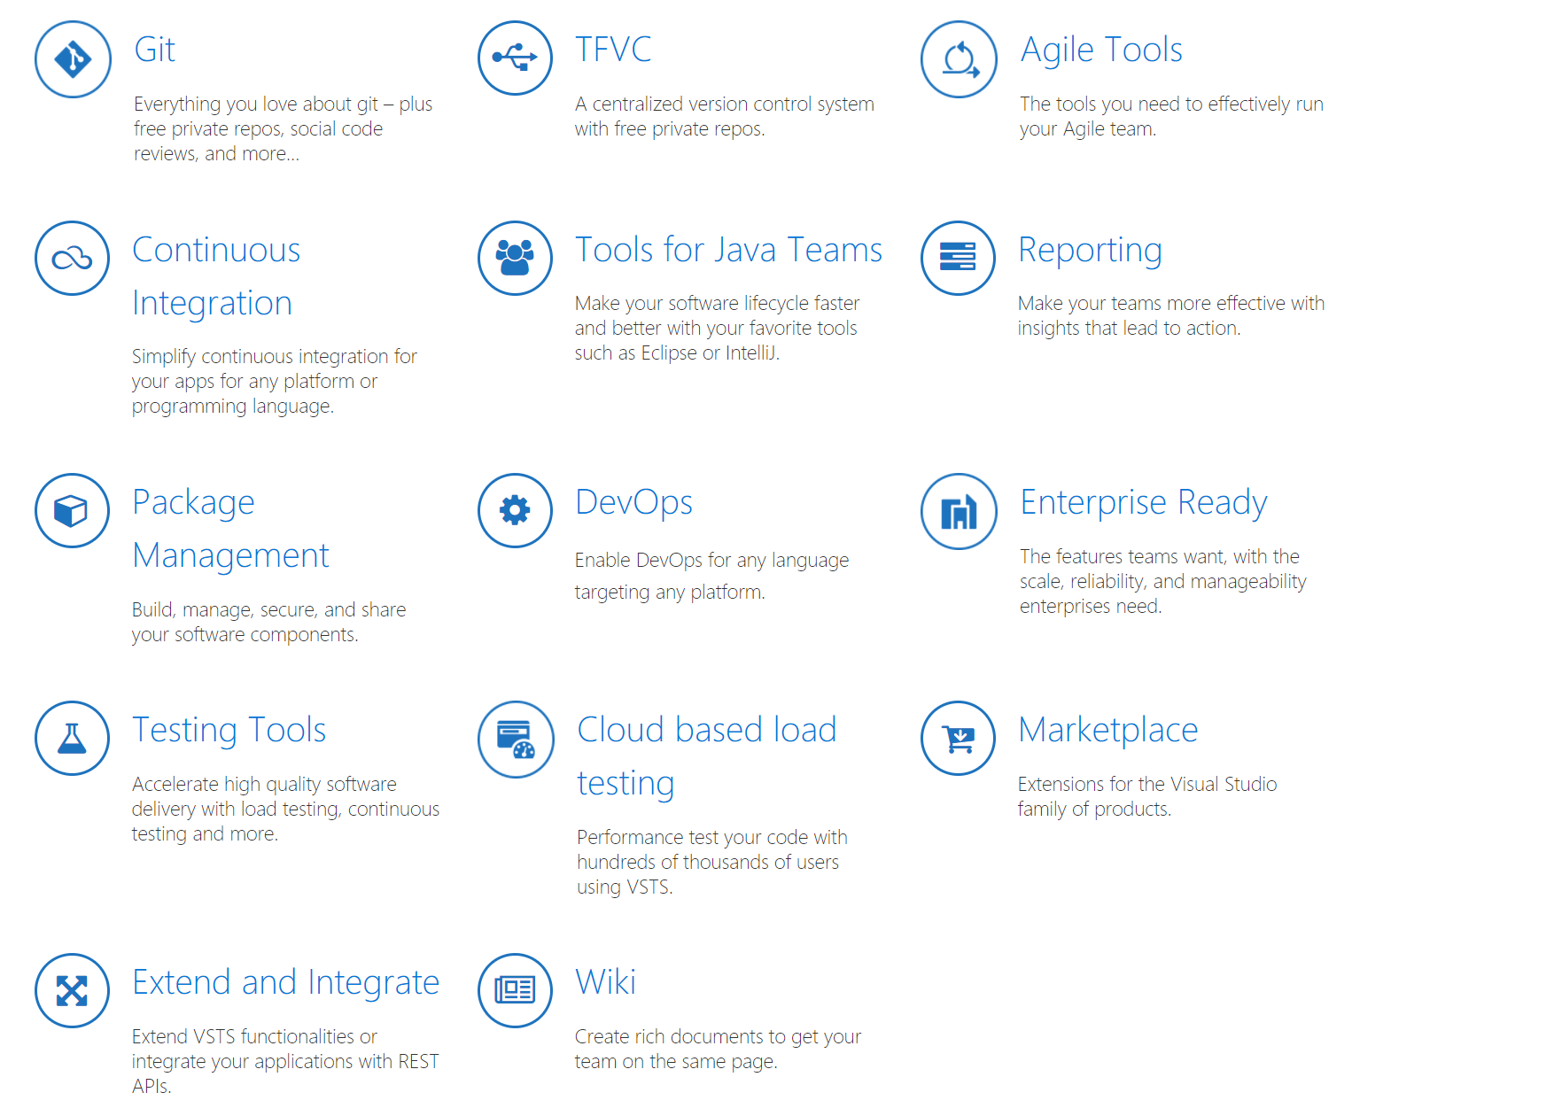
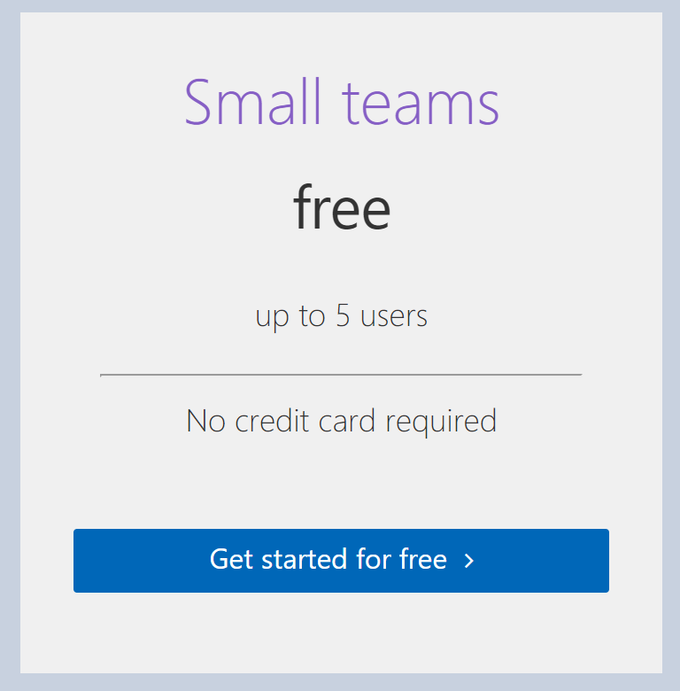
Visual Studio Team Services
https://visualstudio.com/team-service

Slide 7
Why VSTS?
FREE!!
Unit Test with Build Step on merge to Development
Update Module Number
Sign Code with Certificate using Secure Files
Publish to Gallery
If you are doing it more than once automate it ☺
Notes:
PowerShell Gallery is not for testing!

Slide 8
Why Module?
Ps1 scripts EVERYWHERE!!
Use them in other scripts
Share them
Modularity
Only export functions user needs

Slide 9
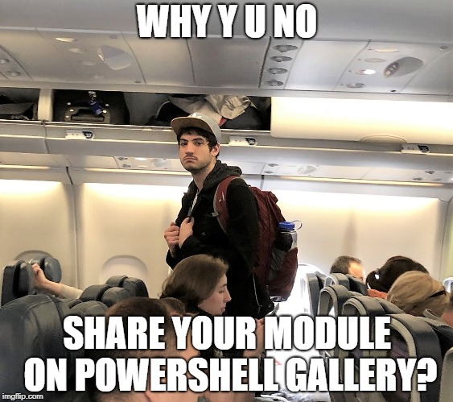
Why PowerShell Gallery?

Slide 10
Why PowerShell Gallery?
Public or Private Nuget Repository
Share your Modules
Make them easier to find
Centralise deployment of Modules

Slide 11
Why Plaster?
Reusability
Parametrisation
Organisational requirements
If you are doing it more than once automate it ☺

Slide 12
Why Pester?
Verify the code is working correctly
Provide design guidance - Support Refactoring
Document the code’s behaviour
Test ScriptAnalyser and Help
If you are doing it more than once automate it ☺
Notes:
Good tests can…
Verify the code is working correctly
Prevent future regressions
Document the code’s behaviour
Provide design guidance
Support refactoring
https://www.devmynd.com/blog/five-factor-testing/

Slide 13

Hey Beardy – Enough Talk!
Time For A DEMO

Slide 14
Summary
Continuous Delivery of PowerShell Module to the Gallery is easy Plaster can template your module framework
Pester is a Unit Testing Framework for PowerShell
VSTS is free
Have Fun – Create some modules today
Rob Sewell @sqldbawithbeard https://sqldbawithAbeard.com

Slide 15
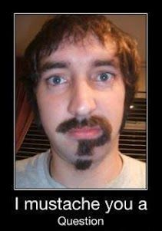
Questions?
?
?
?
?
?
?
?
?
?
?
?
?
?
?
?
?
Rob Sewell @sqldbawithbeard https://sqldbawithAbeard.com

